Slide 1

Laptop Price Prediction for Smart Tech Co.
Presented by: Anju Abraham
ID: S8044

Slide 2
Major Objectives
1) Accurate Pricing: Develop a model that can accurately predict laptop prices based on various features, helping our clients stay competitive in the market.
2) Market Positioning: Understand how different features contribute to pricing, enabling Smart Tech Co. to strategically position its laptops in the market.
3) Brand Influence: Assess the impact of brand reputation on pricing, providing insights into brand perception and market demand.

Slide 3
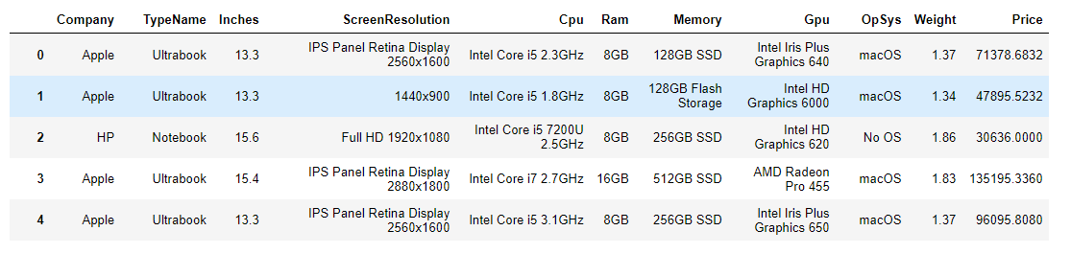
Data exploration

Slide 4
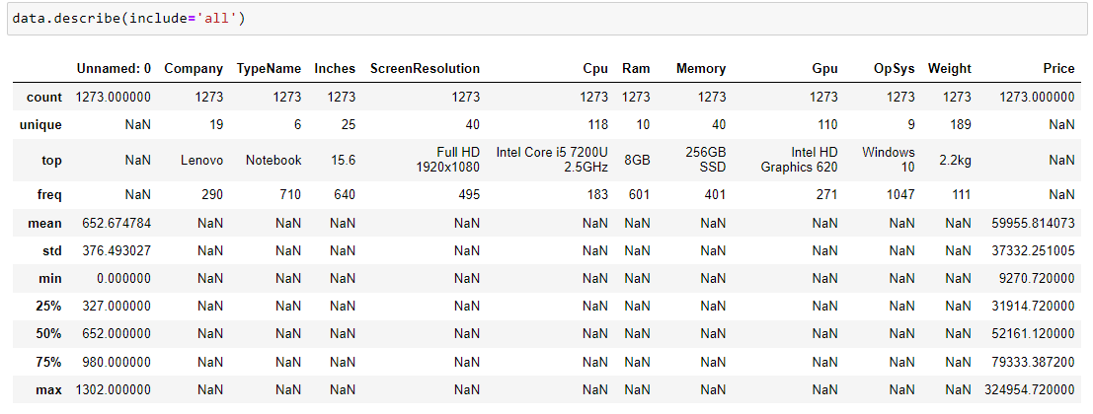
Data exploration

Slide 5
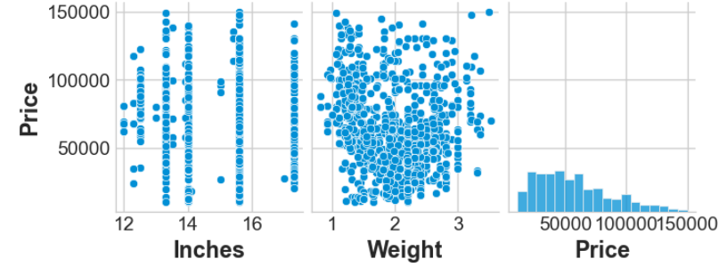
Data exploration
The screen inches, weight does not significantly affect prices
Laptops of all sizes and weights had various prices ranges

Slide 6
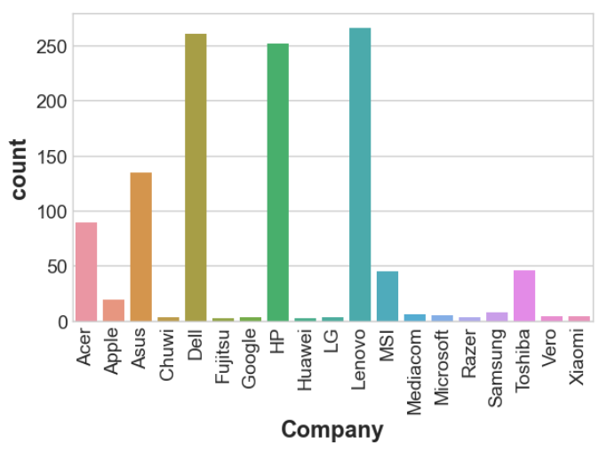
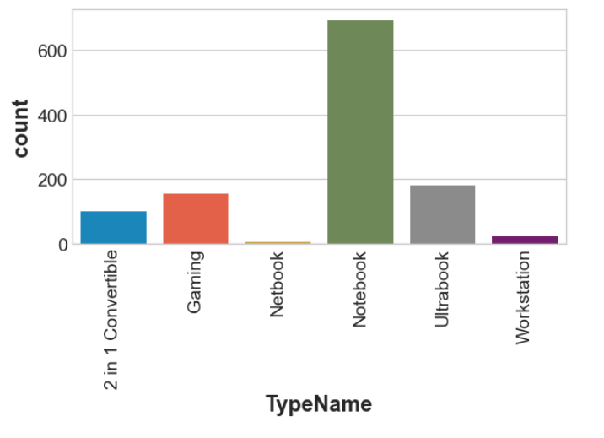
Data exploration

Slide 7
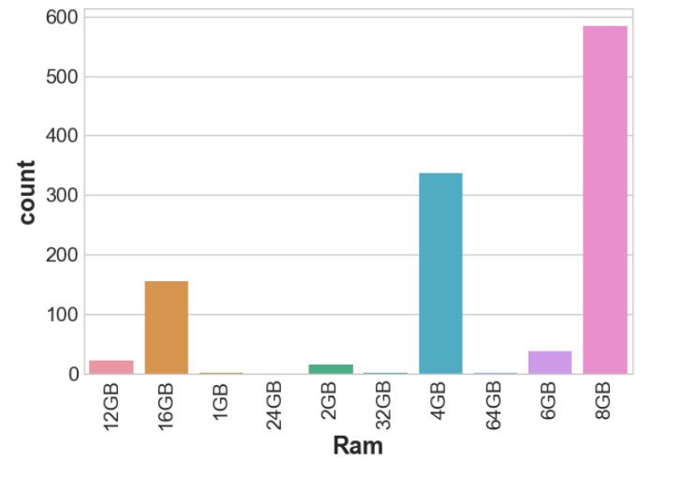
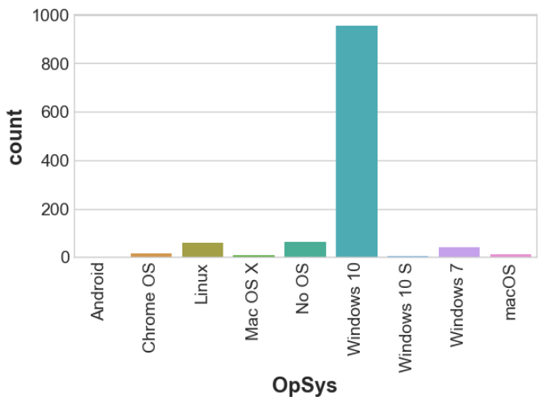
Data exploration

Slide 8
Data preprocessing
30 rows had missing values in all columns. Also, 3 cells had placeholder (?) values. These rows were removed.
Outliers were removed using IQR method.
The data was split into training and validation data using train_test_split
One-hot encoding was used for columns with low cardinality while Ordinal encoding was used for columns with high cardinality.
MinMaxScaler was used for scaling the numerical columns.

Slide 9
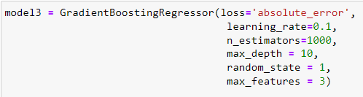
Model Development
Random Forest Regressor, Linear Regression and Gradient Boosting Regressor were used to train on the data. Pipelines were used for simplicity.
Since Gradient Boosting Regressor had the least MAE, it was chosen. The parameters were tuned by trial and error.
The Mean Absolute Percentage Error was found as ~15.6%. The MAE was ~7998.
Model | MAE
Linear Regressor | 10578
Random Forest Regressor | 9320
Gradient Boosting Regressor | 7998

Slide 10
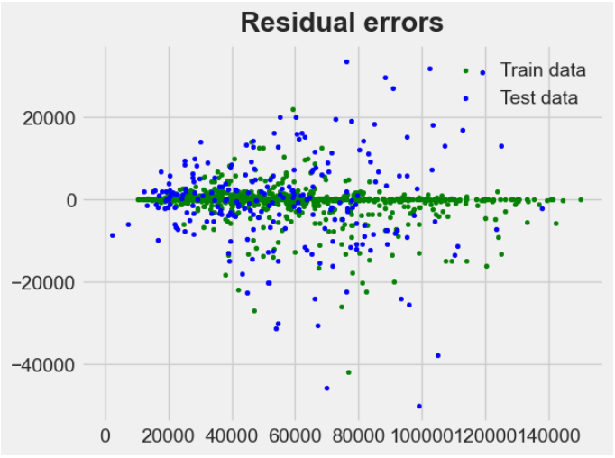
Residual error

Slide 11
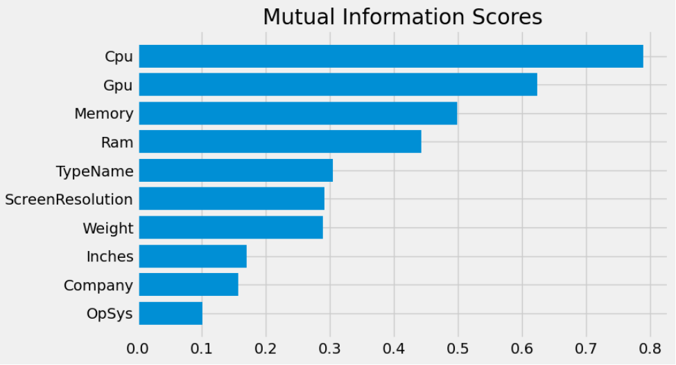
Interpretability and Insights
Mutual Information scores was used to find features playing pivotal roles.
CPU, GPU, Memory & RAM had the most significant impact on laptop prices
The company, operating system, screen inches had least influence on the price

Slide 12
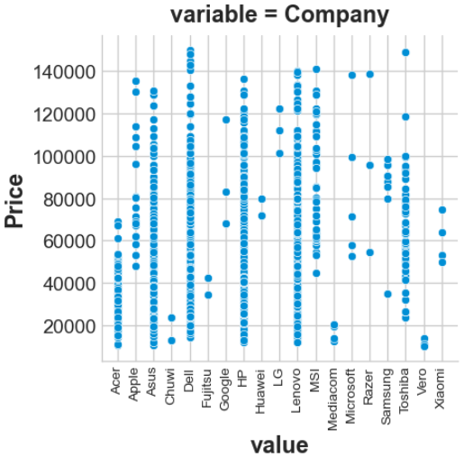
Interpretability and Insights
Asus, Dell, HP, Lenovo are the most popular brands
Laptops of popular brands had a wide range of prices indicating that brand name does not significantly affect prices

Slide 13
Recommendations and Insights
CPU, GPU, Memory & RAM had the most significant impact on laptop prices
The prediction for lesser known brands had a MAPE of 21%. Since less data is available for lesser known brands, accuracy is comparatively lesser.
The brand of the laptop does not significantly influence its price
Occurrence of categorical columns with high cardinality and less number of numerical columns are the challenges faced in prediction
The model predicts the prices of laptops in the validation set with good accuracy (MAPE ~15.6%)
The company, operating system, screen inches had least influence on the price
The most in-demand features were:
Brand-Lenovo, HP, Dell
Type- Notebook
RAM- 8 GB
OS-Windows10

Slide 14
Thank you

